Slide 1



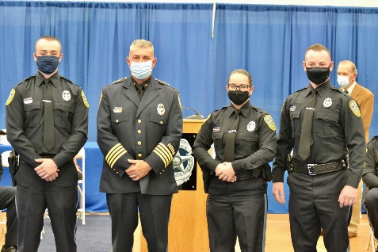
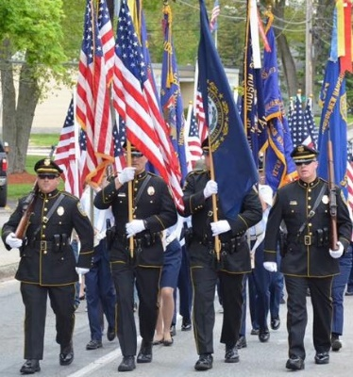



Hudson Police Officer Testing
Date: Thursday, 28 September 2023
Time: Registration at 5 PM
Location: Alvirne High School
200 Derry Street
Hudson, NH 03051
-Applications are available at
www.PoliceApp.com/HudsonNH
-Application deadline is September 27th 2023.
- Certified officers starting range up to $60,112 - $67,953 see PoliceApp.com for certified process open throughout the year.
-For more information, contact Master Patrol Officer Ronald Cloutier at (603)816-2272.
The Hudson Police Department is an Equal Opportunity Employer.
All are encouraged to apply.

