Slide 1


Slide 2




WEST WARWICK
POLICE DEPARTMENT
The West Warwick Police Department consists of a compliment of 52 sworn officers supported by a professional staff of 15 civilian employees. The department provides Law Enforcement services to a population of approximately 30,000 residents who reside within 8 square miles.
The West Warwick Police Department is commanded by Colonel Ernest Lavigne, Chief of Police.

Slide 3

West Warwick Police Department
Vision Statement
To be recognized as the most professional, well respected, highly trained, proactive, community-oriented, municipal law enforcement agency in Rhode Island.

Slide 4
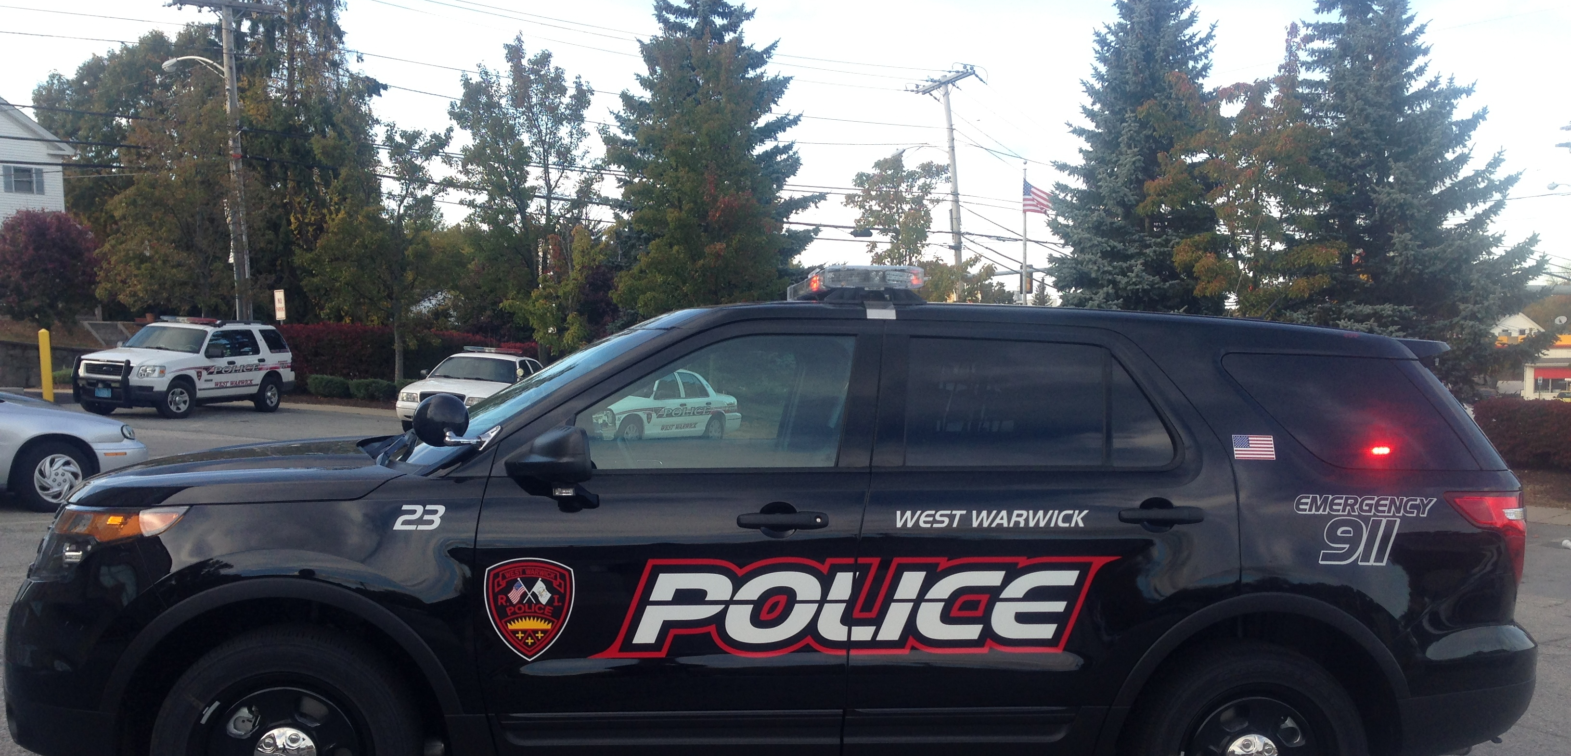
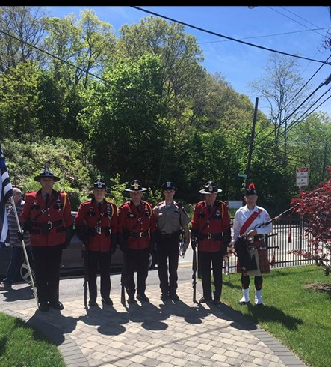
West Warwick Police Department

Slide 5

Why the West Warwick Police Department?
Competitive Wages & Benefits Offerings
Retirement Plan - Retirement Plan through the State administered Municipal Employees Retirement System (MERS) for Police. Retiree health insurance coverage until age 65.
Health & Dental Plans – low cost plans for you and your family through Blue Cross and Delta Dental RI.
Time Off- Generous Vacation, Sick, Personal days earned annually. Opportunities to sell back unused time.
Wages – Earn $1,057 weekly while in the academy. Increased to $1,123 weekly while in the FTO program and then $1,189 weekly as a probationary Police Officer.
Longevity Bonuses – Annual longevity bonuses after four years of service.
Wellness stipends, clothing allowances, life insurance, tuition reimbursement and more!

Slide 6

Qualifications
In order to be eligible to apply, applicants must:
Be a United States Citizen
Be at least 21 years of age by July 1, 2023
Possess a valid driver’s license
Possess a high school diploma or have obtained a General Equivalency Diploma
Have earned at least thirty (30) college credits from an accredited institution recognized by the US Department of Education by February 1, 2023 OR Served at least one (1) years in the US Military on active duty OR National Guard/Reserve military duty by February 1, 2023.
Be of good moral character

Slide 7

Interested in Applying?
Simply go to: www.policeapp.com
Search for Town of West Warwick and apply online.
Application period open through February 1, 2023.

